Slide 1

AWS Machine Learning Engineer - Associate
Apache Spark
Distributed Data Processing for Big Data and Machine Learning
- RJ Programming

Slide 2

What is Apache Spark?
Open-source distributed computing framework
Designed for large-scale data processing
Performs in-memory computation
Faster than Hadoop MapReduce
Supports batch and real-time processing
Widely used for analytics and ML

Slide 3
Why Apache Spark
High-speed processing
In-memory data storage
Scalable distributed architecture
Supports multiple programming languages
Simplifies big data analytics
Integrates with cloud platforms

Slide 4
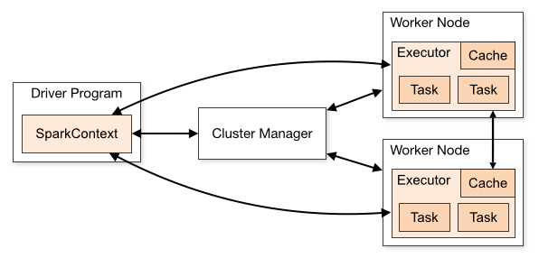
Spark Architecture

Slide 5
How Spark Works
Load Data
Create RDD/DataFrame
Apply Transformations
Execute Actions
Return Results

Slide 6
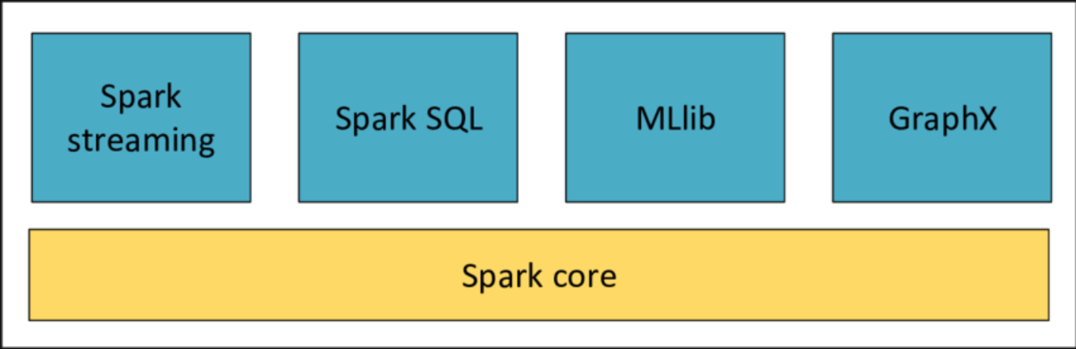
Core Spark Components

Slide 7
Mllib: Machine Learning Library
Built-in machine learning framework
Classification algorithms
Regression algorithms
Clustering algorithms
Recommendation systems
Feature engineering tools

Slide 8
Spark Integration with Other Frameworks
Hadoop HDFS
Apache Hive
Apache Kafka
Amazon S3
Amazon EMR
Amazon SageMaker

Slide 9
Apache Spark on AWS
Runs on Amazon EMR
Uses Amazon S3 as storage
Integrates with AWS Glue
Supports SageMaker workflows
Scalable cloud-based processing
Cost-efficient analytics platform

Slide 10
Summary
Spark is a distributed processing framework
Faster than traditional MapReduce
Uses in-memory computing
Includes MLlib for machine learning
Integrates with Hadoop, Kafka, S3, and SageMaker
Core technology in modern AWS ML pipelines

Slide 11
                THANK YOU

